Slide 1
EDA - Task
Analysis of credit Applications

Slide 2
Application data

Slide 3
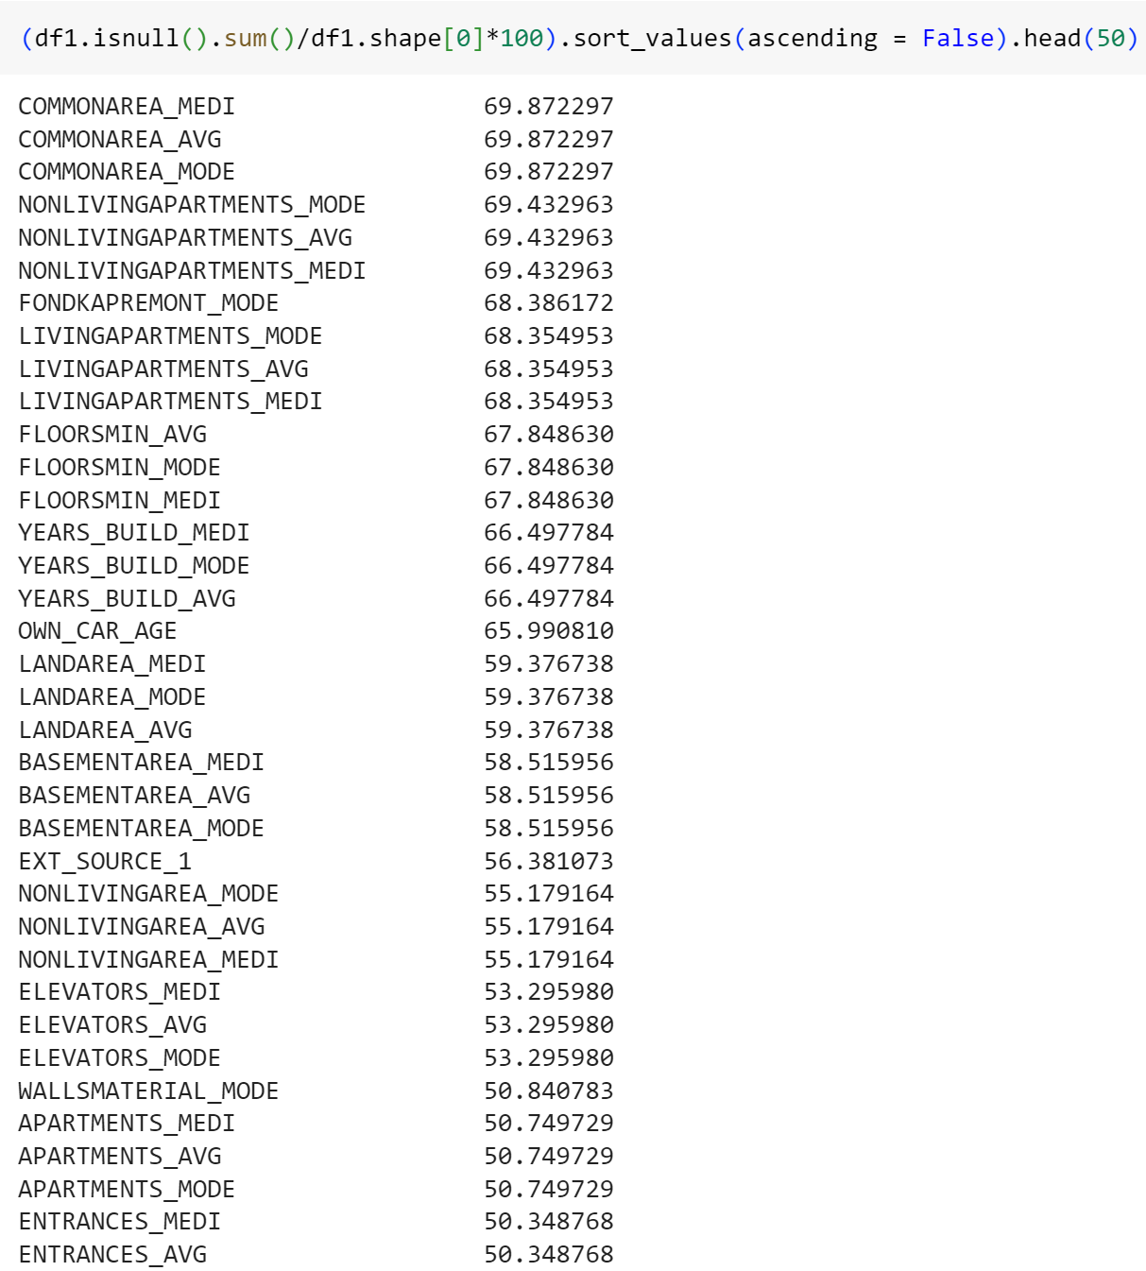
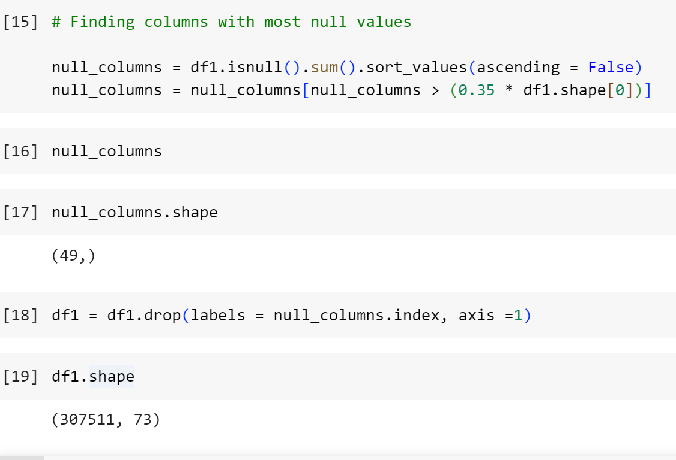
Null Values
Dropping all columns with more than 35% null values

Slide 4
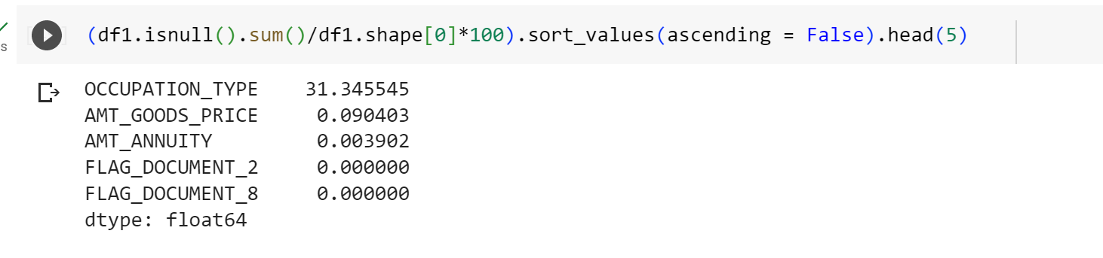
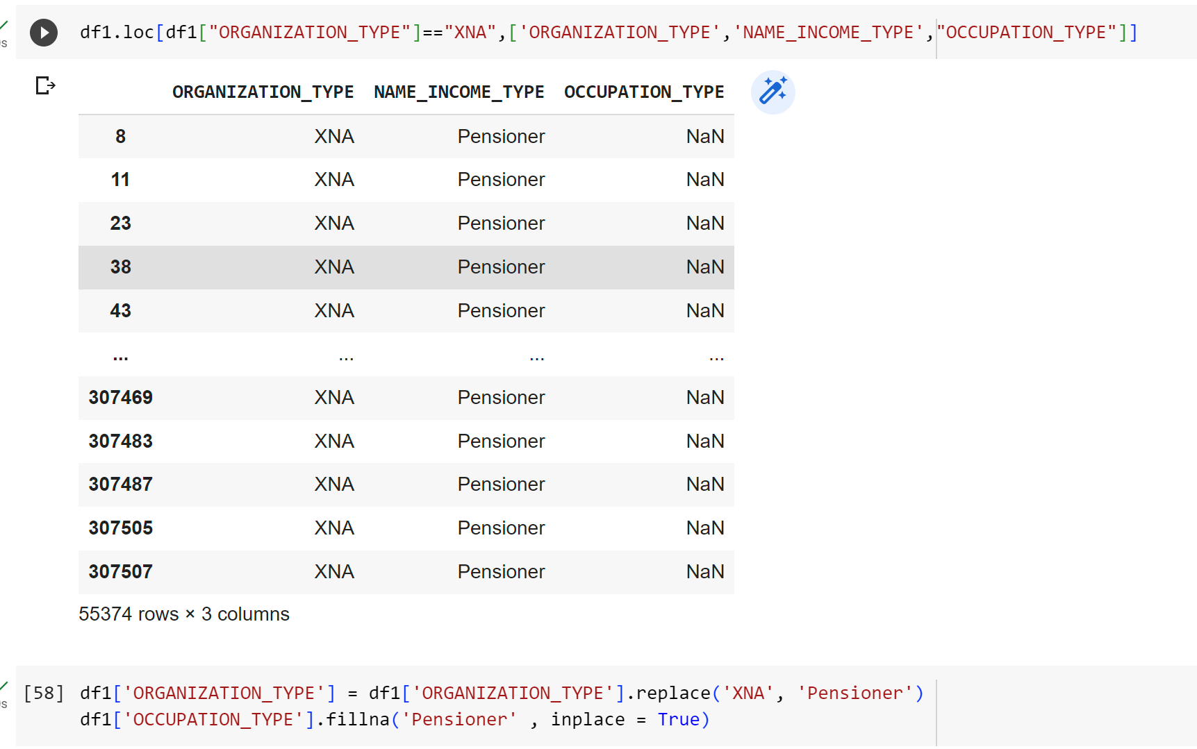
Imputing
Unwanted columns
Categorical values are imputed with mode and numerical values with median
Flag document and other unwanted columns are dropped

Slide 5
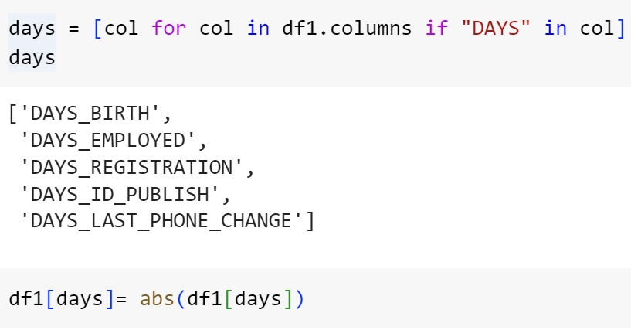
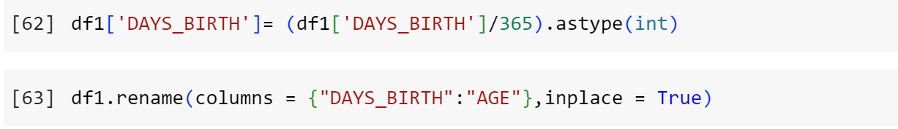
Cleaning and organising columns
The days are negative so they are made to positive values.
Age is calculated from DAYS_BIRTH

Slide 6
Outliers
Amount of total income has very slim distribution with a lot of outliers
Third quartile of credit amount is larger as compared to the First quartile which means that most of the Credit amount of the loan of customers are present in the third quartile. And there are a large number of outliers present in credit amount
From boxplot of CNT_FAM_MEMBERS , we can say that most of the clients have 4 family members. There are some outliers present
Most people who get credit own real estate

Slide 7
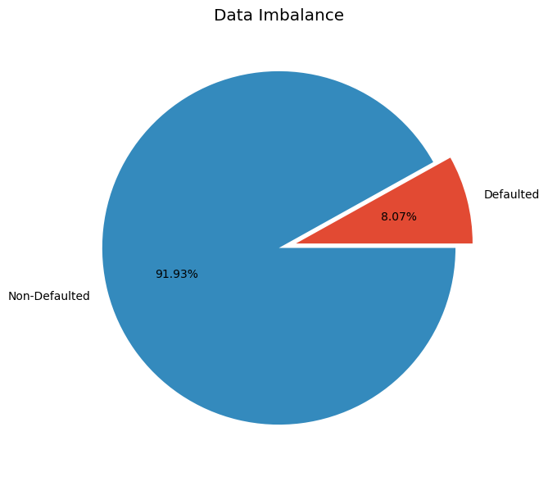
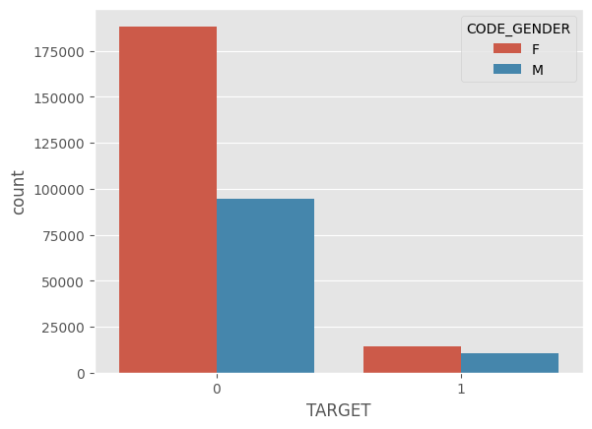
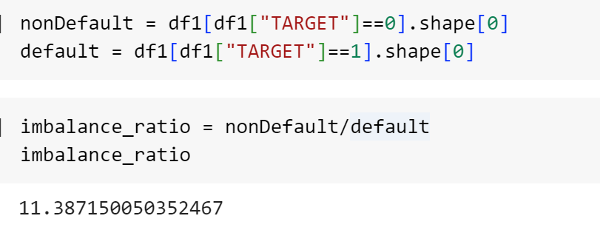
Data Imbalance
The data is highly imbalanced with only 8.1% defaulted population

Slide 8
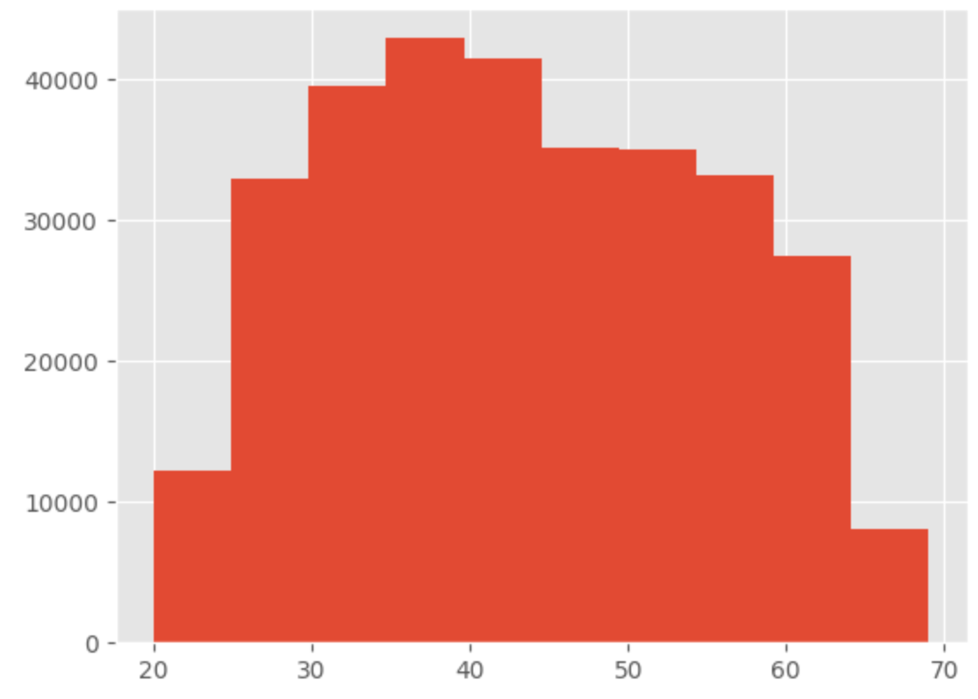
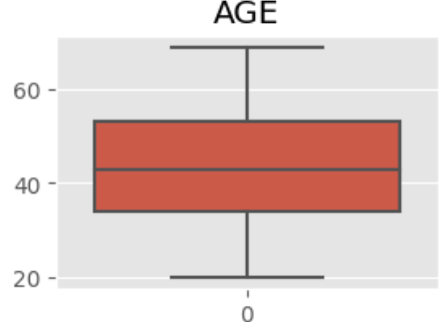
Data Analysis
Age:
People in the age range 35 to 45 get the most credits

Slide 9
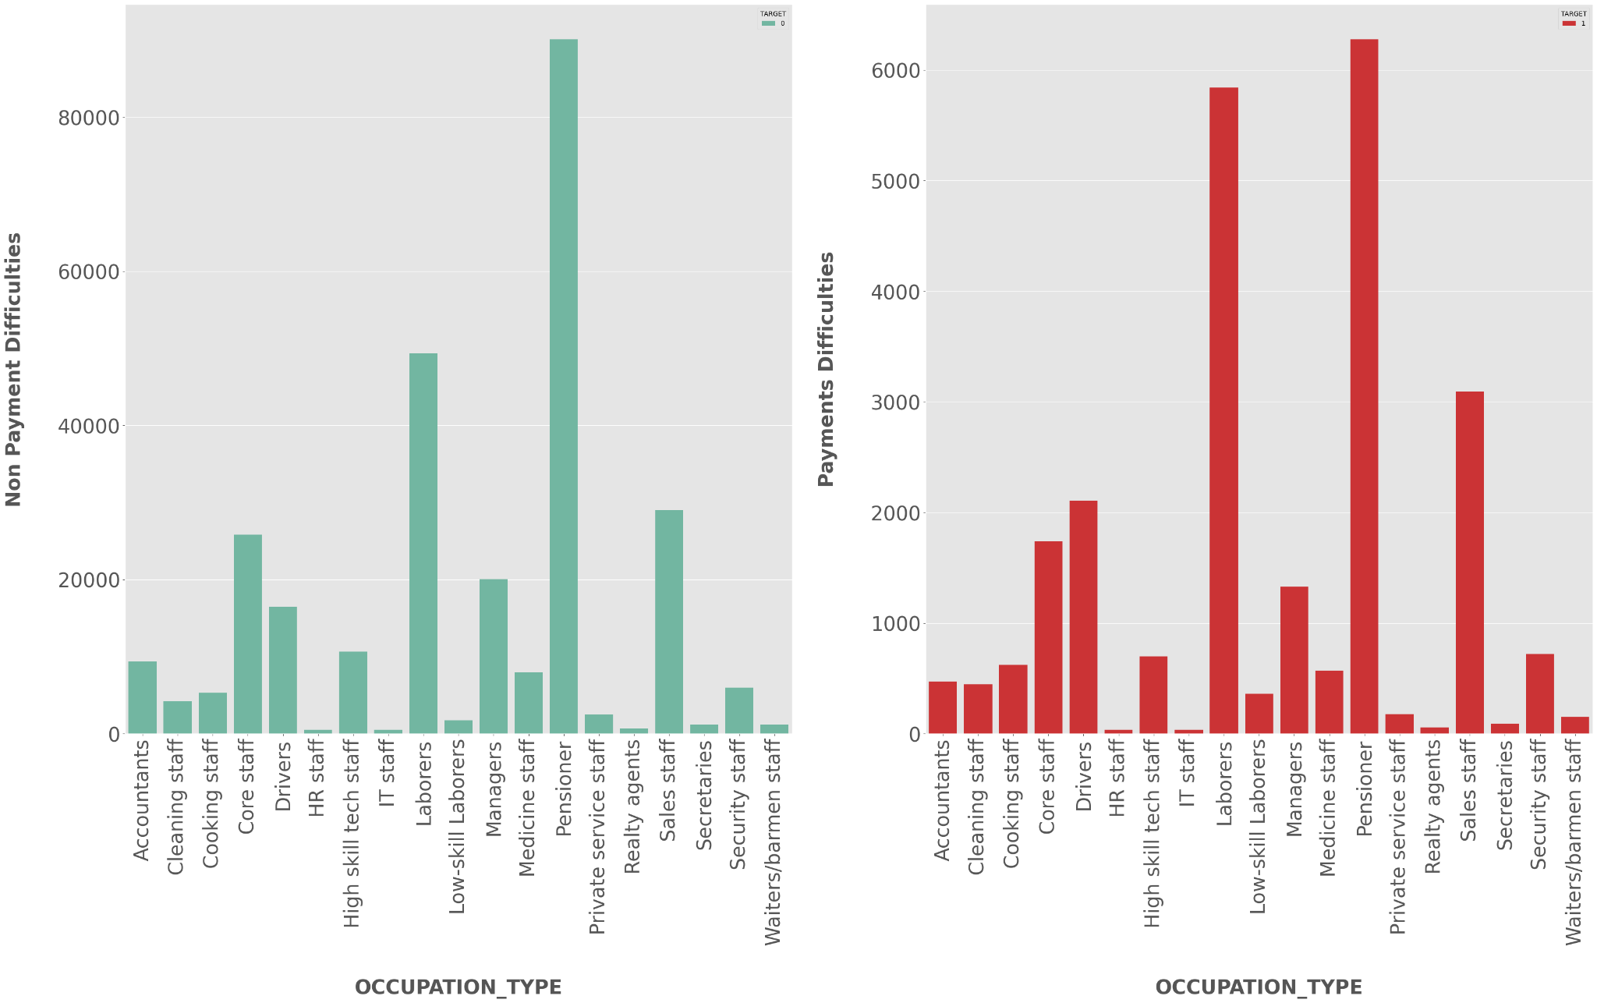
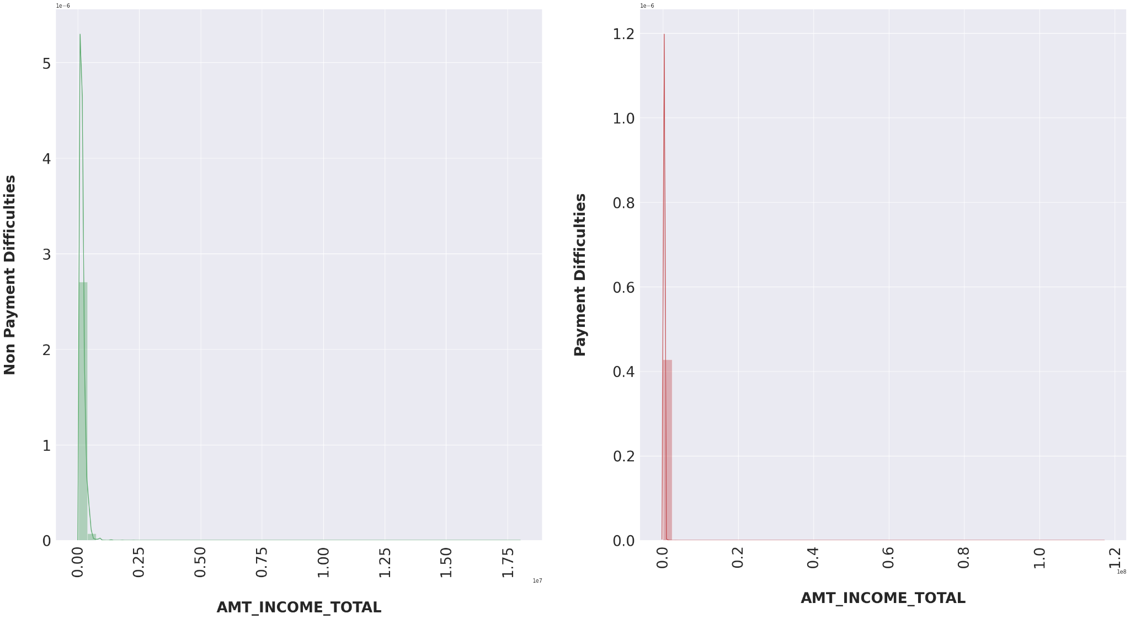
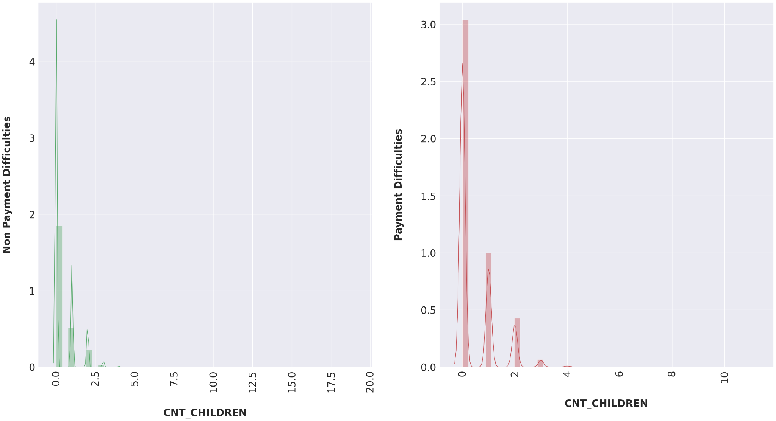
The ratio of Labourers is high in defaulters than non defaulters
People who defaulted have lesser total income on average 0.4*1e-6 compared to that of non defaulted population with average 2.8*1e-6
It can be seen that the defaulted population has a lot more entries with 0 children than that of non defaulted

Slide 10
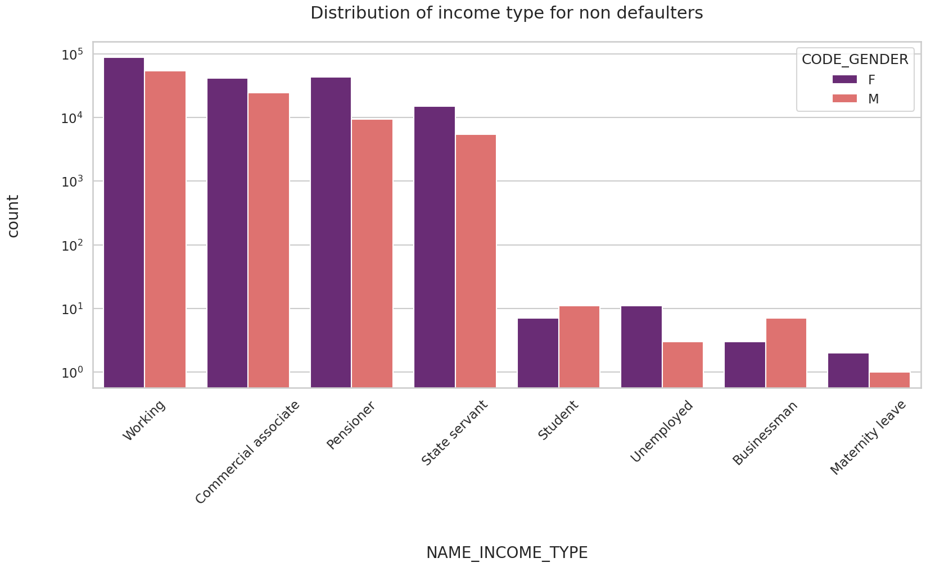
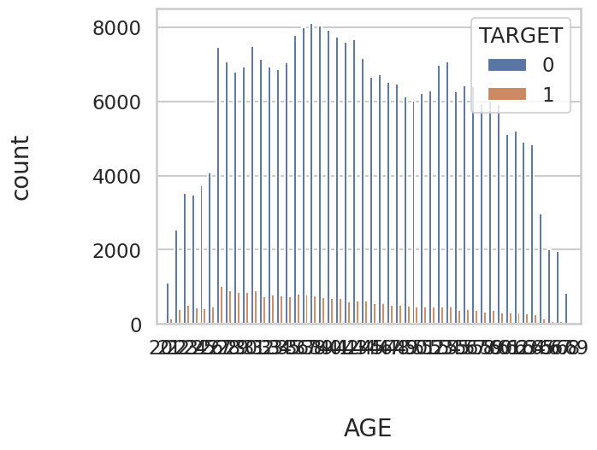
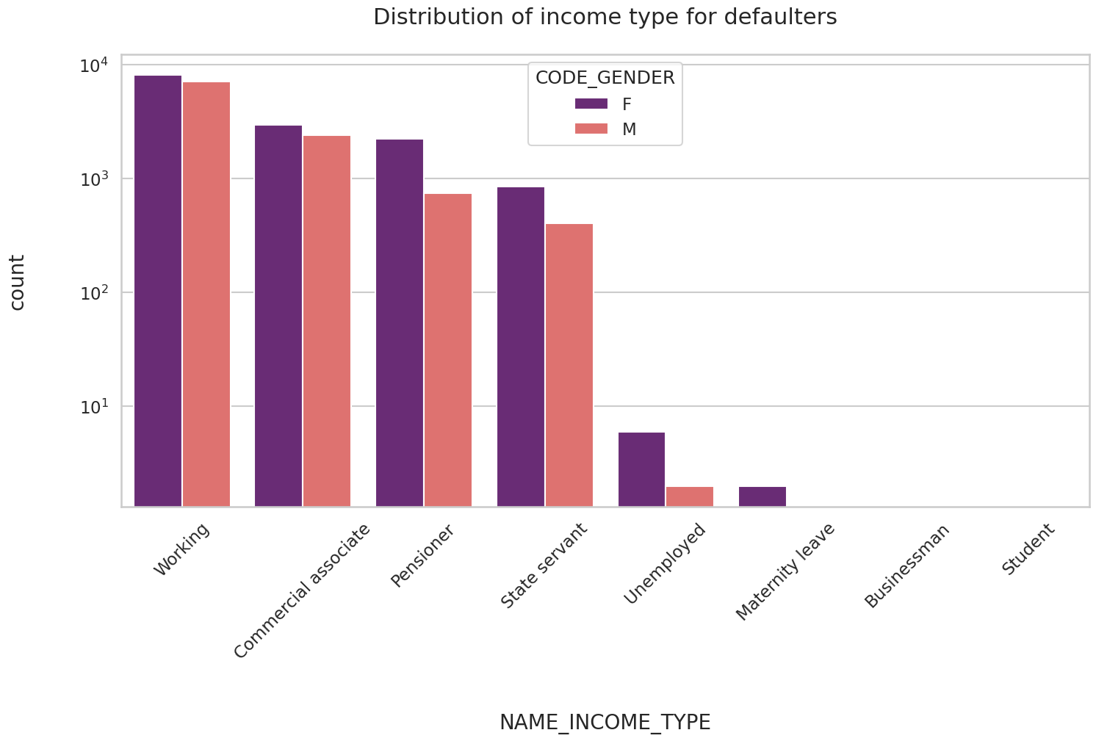
- Female clients seem to have applied for loan more than male clients
- Businessmen and Students have no defaults so banks should focus more on giving loans to students and businessmen
- Working class is more likely to apply for loans than students and businessmen
With increase in age the number of defaulters reduces

Slide 11
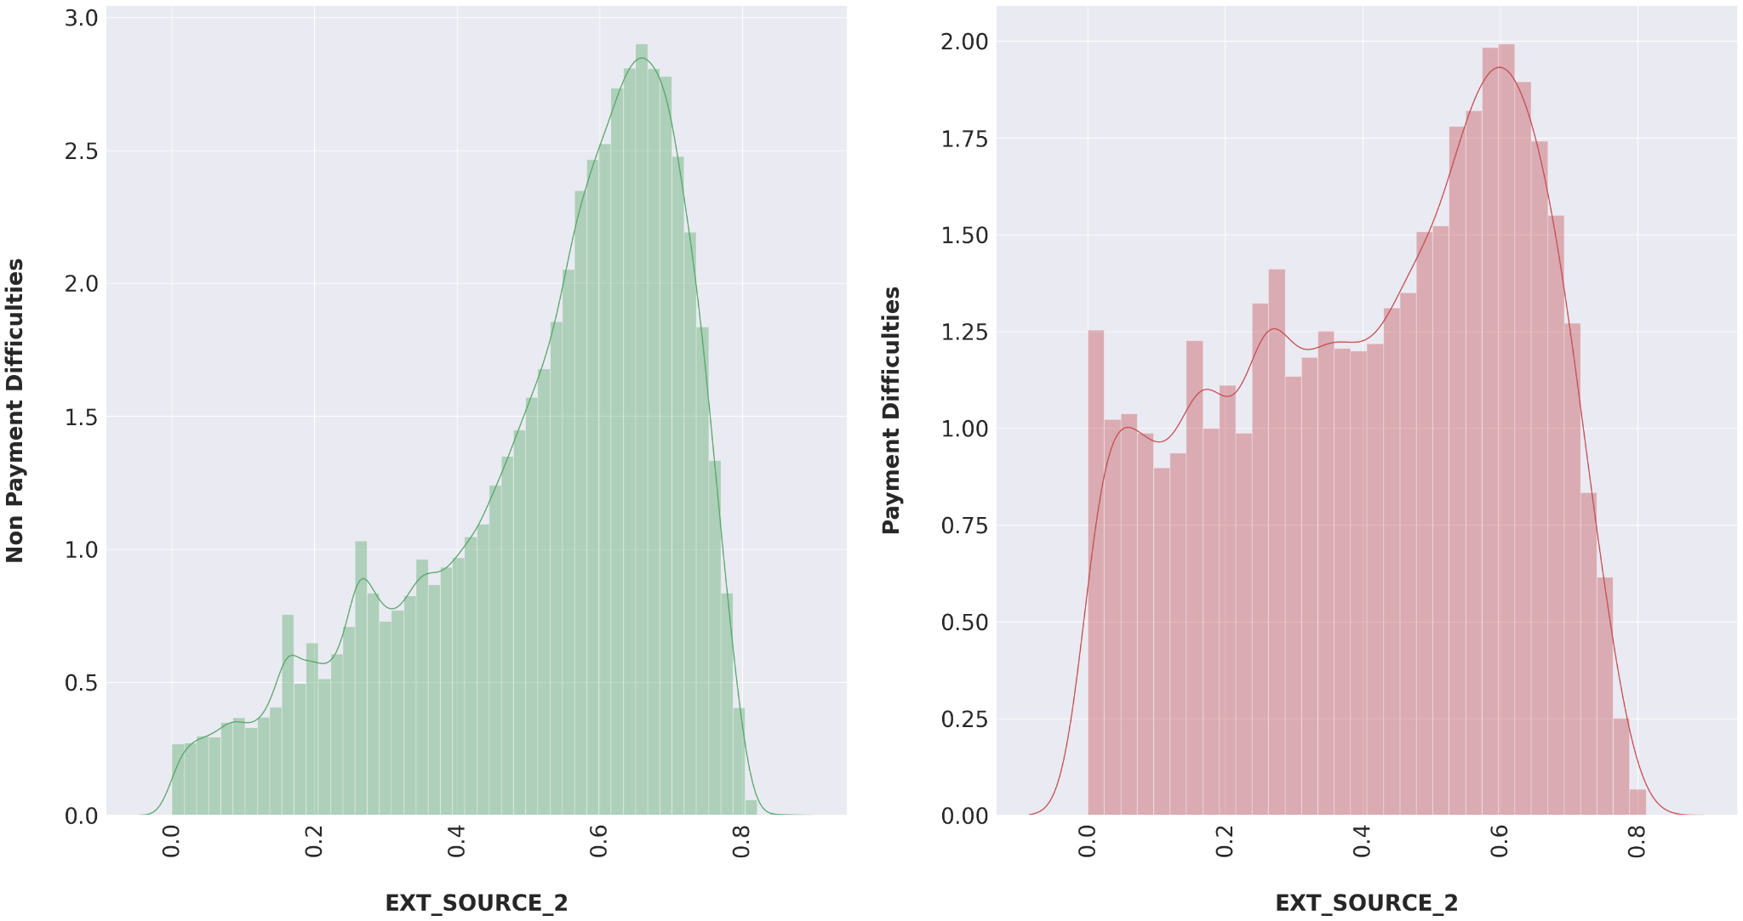
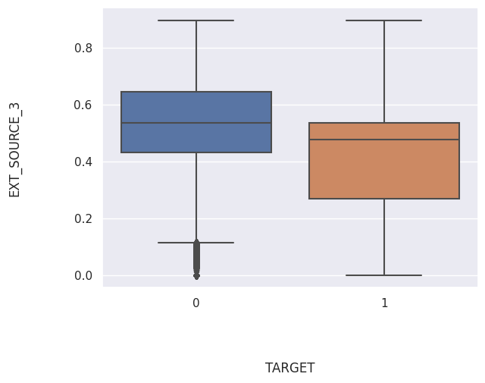
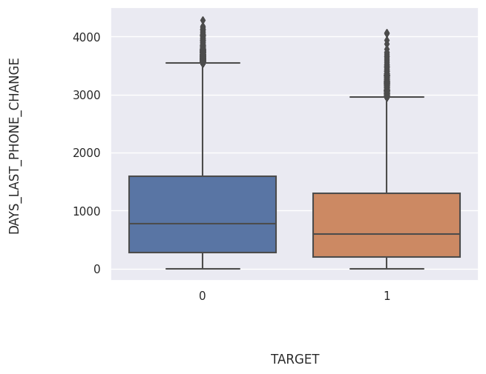
Defaulters have more external source scores than non defaulters
People who defaulted tend to have changed their phone more recently

Slide 12
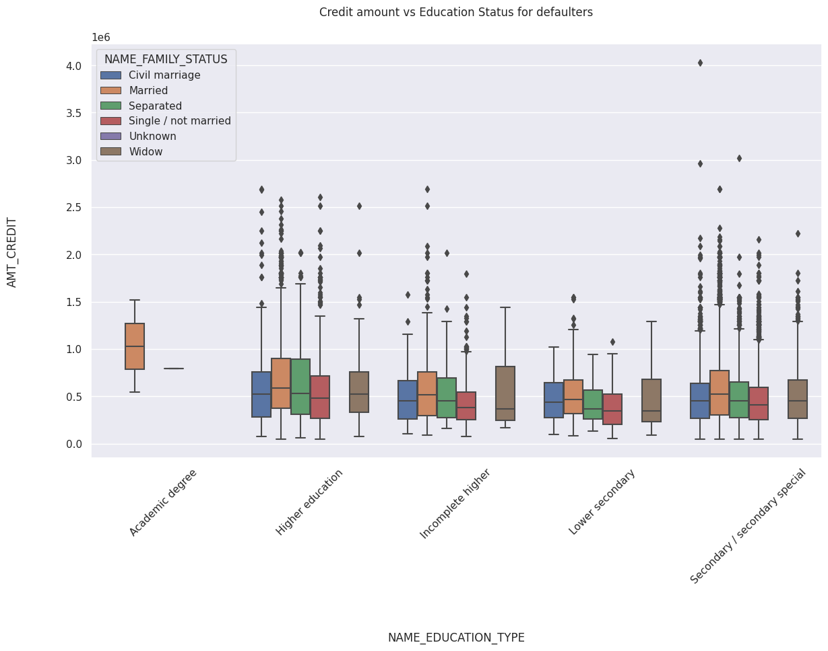
People with academic degree don’t default except those who are also married
Married people tend to get more credits than separated or unmarried people for both groups of population

Slide 13
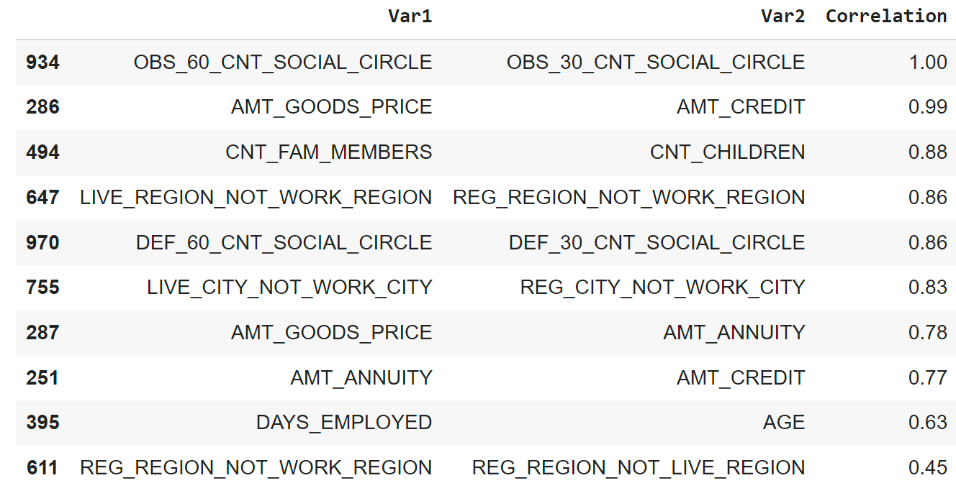
Variables with Most Correlation - Non default

Slide 14
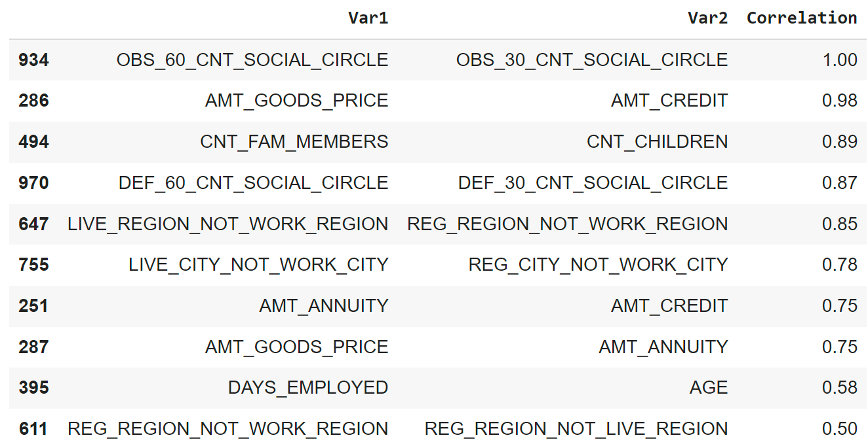
Variables with Most Correlation - Defaulted population

Slide 15
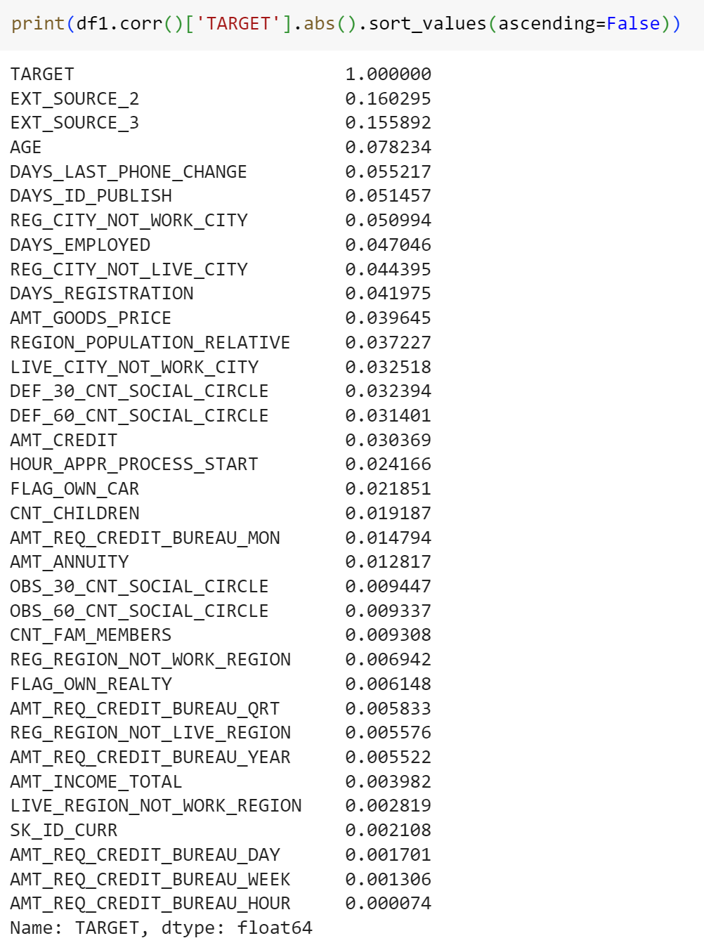
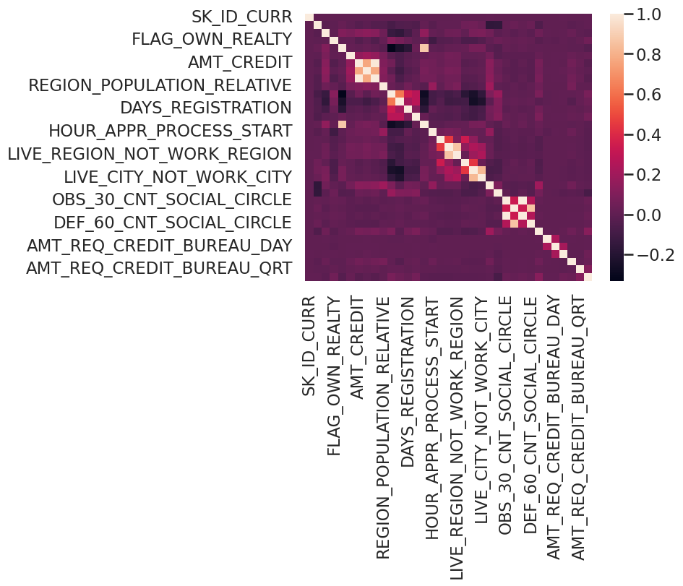
Correlation
External sources, age and days since last phone change are highly correlated to Target

Slide 16
Previous Application data

Slide 17
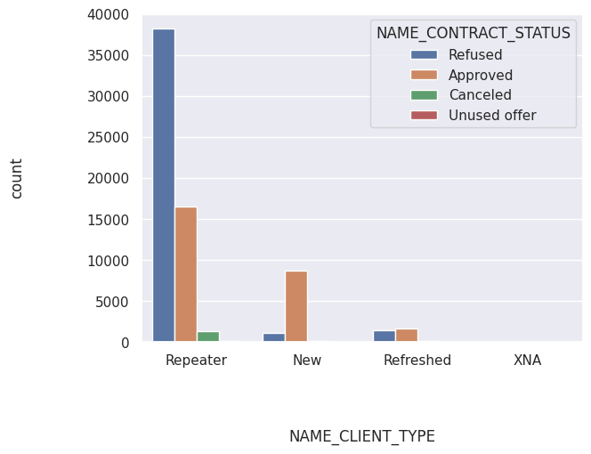
Repeaters loans are mostly refused while new clients loans are approved

Slide 18
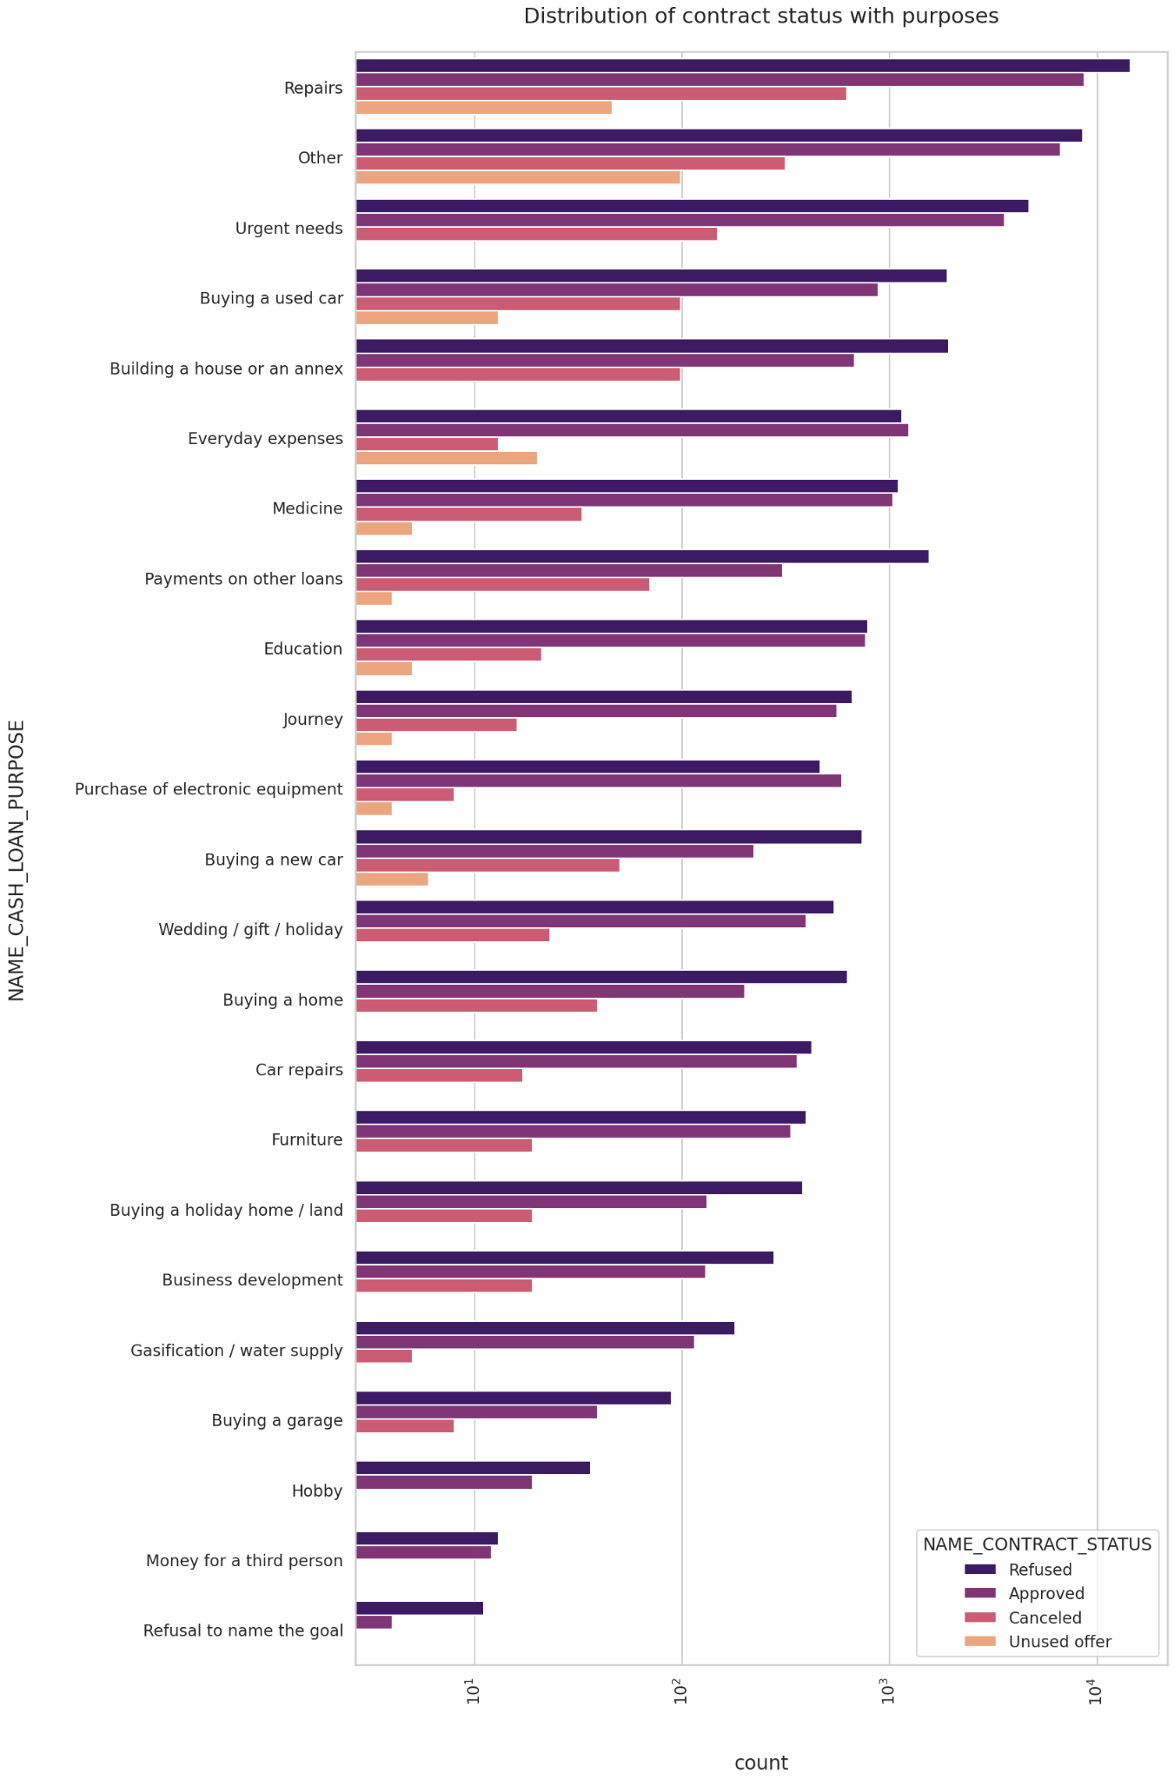
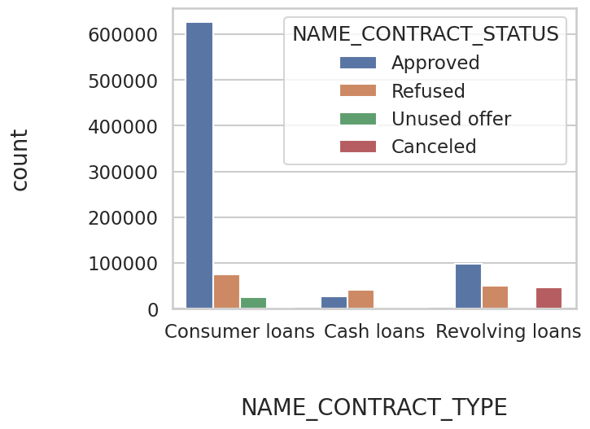
Repair work loans are the most rejected.
Everyday expense loans and electronic equipment purchase loans are approved more than they are rejected
Consumer loans is the most common type of loan and it has very high approval rate

Slide 19
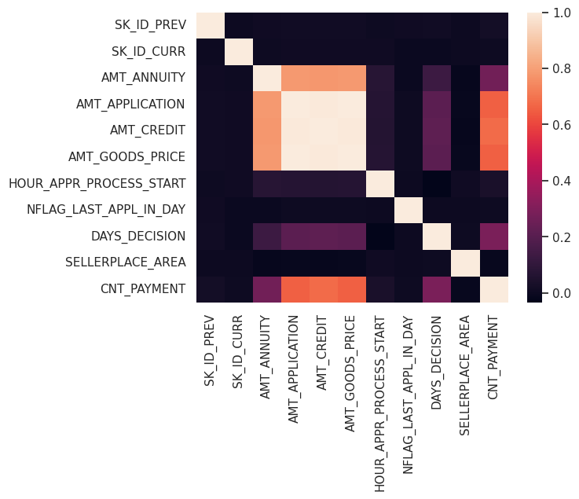
Correlations
Annuity , application amount and credit amount have high positive correlation with each other

Slide 20
Conclusions

Slide 21
Banks should focus more on Students and Businessman as they have more successful payments
Loans with repair as purpose are mostly rejected as they have more unsuccessful payments
Low external source scores must be preferred when giving loans
As age increases default rate decreases
Labourers have high risk of default
People with children default less than people with no children
Repeaters loans are mostly refused

